Slide 1
An Introduction to Flutter
Don Ward
Quicken Loans
Senior Research Engineer
donward@quickenloans.com

Slide 2
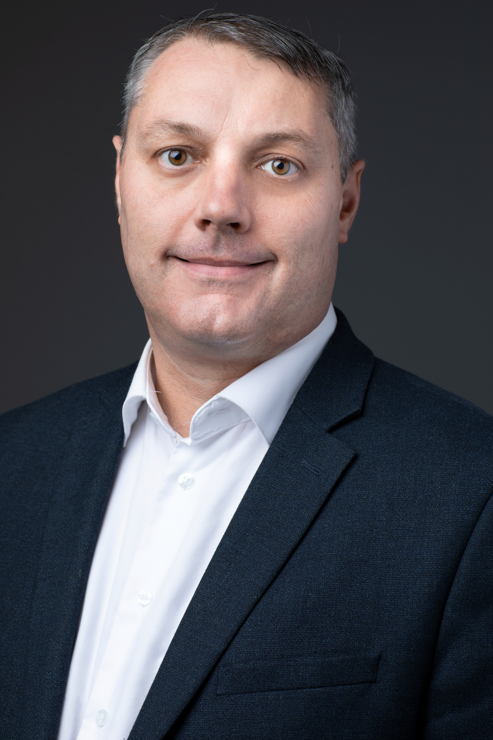

Who am I?
Led Quicken Loans Mobile Team for a few years
Founder and Co-Lead GDG Detroit for 7 years
Founder and Leader of GDG Windsor ~ 1 year

Slide 3


The Agenda
What is Flutter?
What is Dart?
Why?
Let’s code!

Slide 4
What is Flutter?
Open Source Cross Platform Mobile Development
Announced 2015
Flutter 1.0 – Dec 2018
Flutter 1.5 – May 2019
Available on iOS, Android, ChromeOS and Web

Slide 5
What is Dart?
Since 2011
Statically typed language similar to JavaScript and Java
Object-oriented
Syntactic sugar

Slide 6

‘Why?’

Slide 7
What are we building today?

Slide 8
We’ll Figure It Out
Quicken Loans ISMs
Notes:
We’ll figure it out

Slide 9











































































More than mortgages…
REAL ESTATE
FINTECH
PRIVATE EQUITY
PARTNERSHIPS
SPORTS / MEDIA / ENTERTAINMENT / GAMING/ HOTELS
FOC INVESTMETNTS
VENTURE CAPITAL

Slide 10


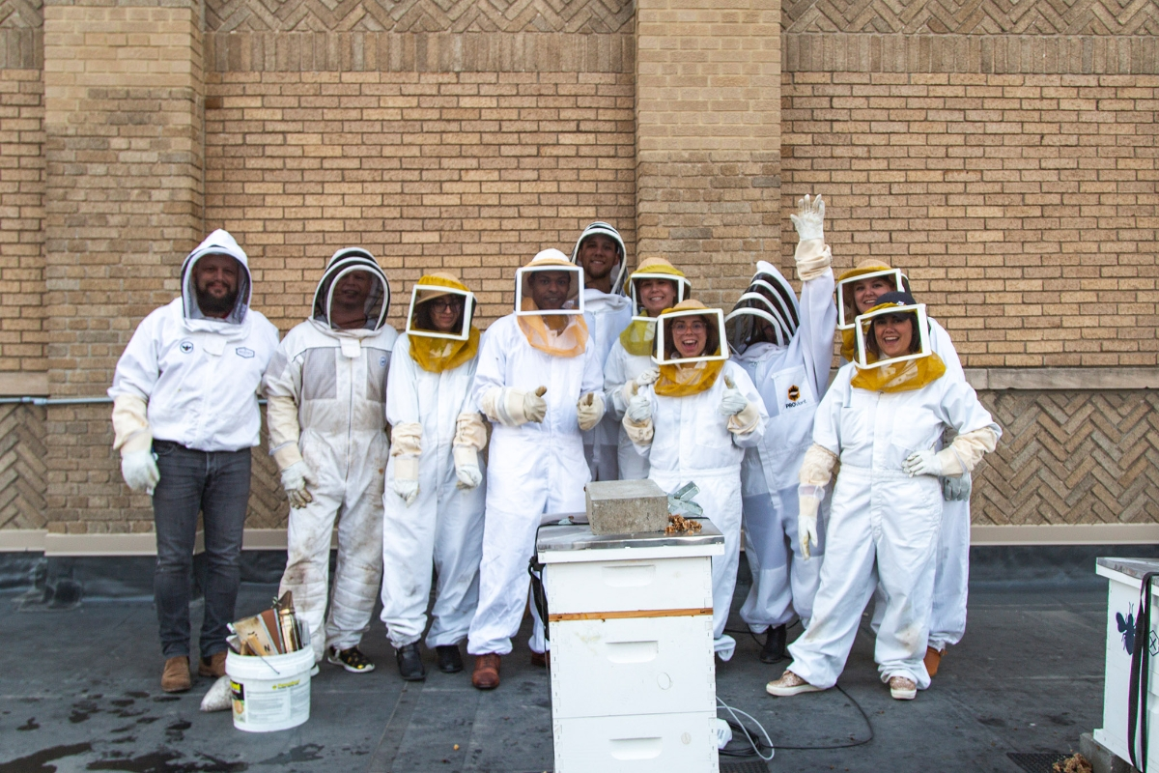


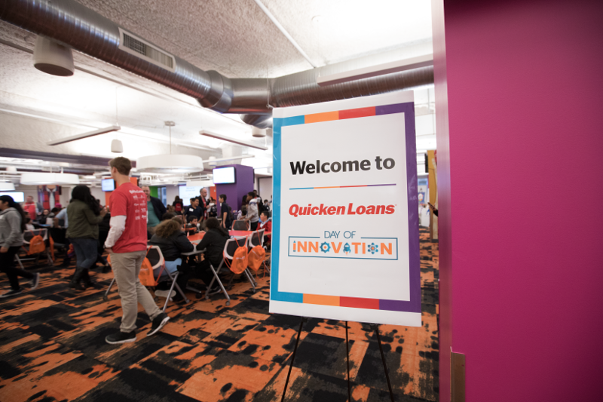
Notes:
Volunteering

Slide 11

Quicken Loans
TECHNOLOGY

Slide 12
Notes:
QL Culture

Slide 13
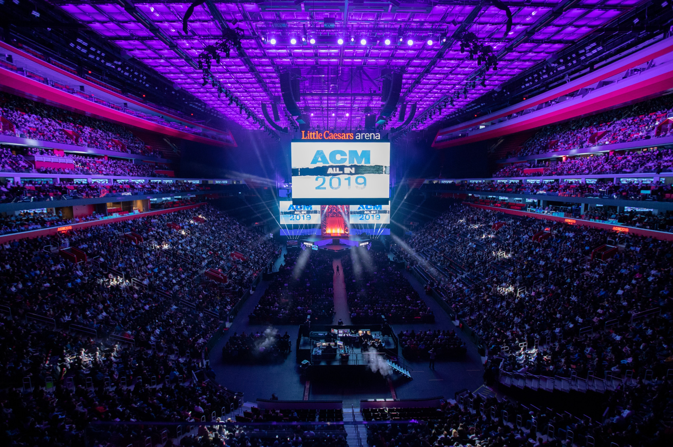
33+ Years
17,000+

Slide 14


Slide 15


Roles of the Future…
Notes:
Future roles – software engineer and data scientist

Slide 16
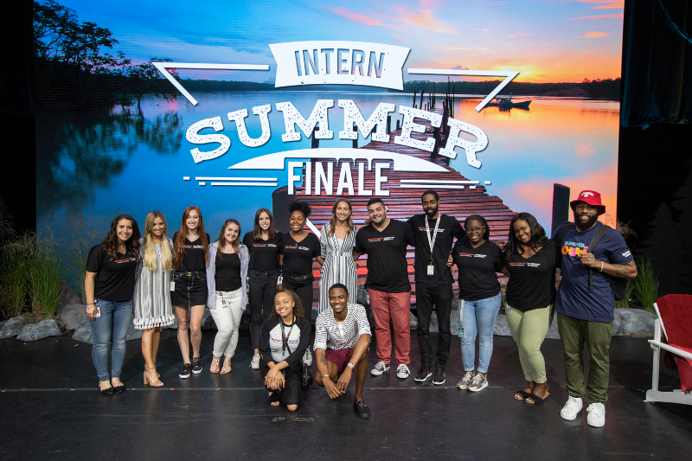

Notes:
Intern opportunties

Slide 17

Notes:
OCM Detroit and contact info

Slide 18

Thank you!
Don Ward
Quicken Loans
Senior Research Engineer
donward@quickenloans.com

